Slide 1
Providing Economic Development
Services in Okanogan County

Slide 2
WHAT IS THE ECONOMIC ALLIANCE?
Alliance 2005 is a 501 (c) 3 non-profit organization. We are governed by a 25 member board of directors who represent the 5 areas of the county, Industry, Small Business, city & county government and the Colville Confederated Tribe.
"The Economic Alliance's mission is to facilitate partnerships with private, government, and tribal entities that will create an environment to nurture, support and recruit businesses and industry in Okanogan County.”
The Economic Alliance promotes economic development in the region through:
Planning
Research
Small Business Advising
Training
Technical Assistance
Infrastructure Development

Slide 3
Where does our Funding Come From??
Annual Funding
Okanogan County .09 Fund for Economic Developments
Washington State Department of Commerce ADO Funding
WA Small Business Development Center (SBA)
Okanogan PUD
Okanogan County Tourism Council
Grant Funding
Washington State Microenterprise Association
Washington Economic Development Finance Authority
Community Foundation of NCW
USDA Rural Business Development Grant Program
Others

Slide 4
Barriers and Challenges that Rural Businesses & Communities Face
Feeling Remote and Isolated
Connectivity-Lack of Broadband infrastructure
Workforce Housing
Lack of Childcare
Available Workforce
Public Infrastructure for growth
Transportation Costs
Capacity: Very small communities that lack staffing to apply for grants or to facilitate projects

Slide 5
How does the E.A. work with Entrepreneurs and
Small Businesses in Rural Okanogan County?
PARTNERSHIPS
Cross-sector partnerships
Develop & sustains authentic, trusting relationships
Honors diverse voices representing Okanogan County’s demographics.
Transparency
Ensure Equitable Access to Resources and Growth Opportunities
•Communication Strategy (Chambers, Twisp Works, Cities, County) Newsletters, Social Media
•Education & Training (SBRTC, PTAC, NNDF, WVC, etc)
•Business Outreach- including marketing materials and trainings in English and Spanish
•Provide 1 on 1 Small Business Assistance through our SBDC (English & Spanish)
•Provide Administrative Support to DMO
•Access to Financial Assistance
•Local Banks (Tribal Credit, NNDF-Native CDFI)
•Craft 3
•Tri County EDD Loan Fund

Slide 6
SMALL BUSINESS RESOURCE &
TECHNOLOGY CENTER (SBRTC)
The SBRTC provides free access to technology such as computers, quality photography equipment, drones, and more, all of which are available for use in our offices or available for checkout. Our conference room is available for use as well, complete with the equipment needed to conduct video conferences or attend online training.
The SBRTC also offers no-cost workshops to educate local small business owners on topics like creating Etsy shops, Social Media Marketing, Bookkeeping Basics, creating an Ecommerce storefront, Building a Brand, Time Management, and more!

Slide 7
SMALL BUSINESS
DEVELOPMENT CENTER (SBDC)
The Washington Small Business Development Center (SBDC) is a network of expert business advisors working in communities across the state to help entrepreneurs or small business owners start, grow or buy/sell a business.
The Economic Alliance’s SBDC advisor Lew Blakeney provides one-on-one, confidential, no-cost advising on all phases of small business development throughout Okanogan County and Colville Indian Reservation.
Other services provided include free workshops on a variety of business topics and customized market research services.

Slide 8
OKANOGAN COUNTY
TOURISM COUNCIL (OCTC)
Okanogan County Tourism Council is the designated Destination Marketing Organization (DMO) for Okanogan County. Their marketing strategies promote all areas in Okanogan Country.
OCTC’s Board of Directors are volunteers and represent the tourism industry to other organizations, gather data, provide ideas, and work to perform certain tasks. Okanogan County Tourism Council recently launched a TV campaign to help bring tourists back to our beautiful county!
In partnership with OCTC, the Economic Alliance performs administrative duties such as fielding phone calls, sending OCTC advertising materials to prospective travelers, and communicating with OCTC’s membership on upcoming meetings and trainings that could benefit the tourism industry.

Slide 9
ECONOMIC DEVELOPMENT/PUBLIC INFRASTRUCTURE PROJECTS
The Economic Alliance has several subcommittees that address Community and Economic Development Projects:
Infrastructure Committee
Abandoned Buildings/Lots
Attainable Workforce Housing
Okanogan County and Colville Confederated Tribes Broadband Action Team
To learn more about these committees and the work they do, please contact me!

Slide 10
SMALL BUSINESS
TRAINING
As mentioned previously, the Economic Alliance holds free Small Business Trainings and Webinars throughout the year. We are always interested in what you would like to learn more about. Please let us know!
Here are some examples of trainings we have held over the last couple of years:
Bookkeeping Basics for your business
Small Business Financing: Access to Capital
Branding Your Business
L&I Updates that impact your small business
Social Media Best Practices
Effective Communication
Youth Employment Resources For Employers
Government Contracting 101
Succession Planning: What is your exit strategy
L & I Updates and Resources for Contractors
Creating your small business website
Pricing Your Products
Farmers Market Management Series
QuickBooks 1 on 1 classes
Customer Service
Photography for your business
Business 101: So you want to start a business
Expanding your business online

Slide 11
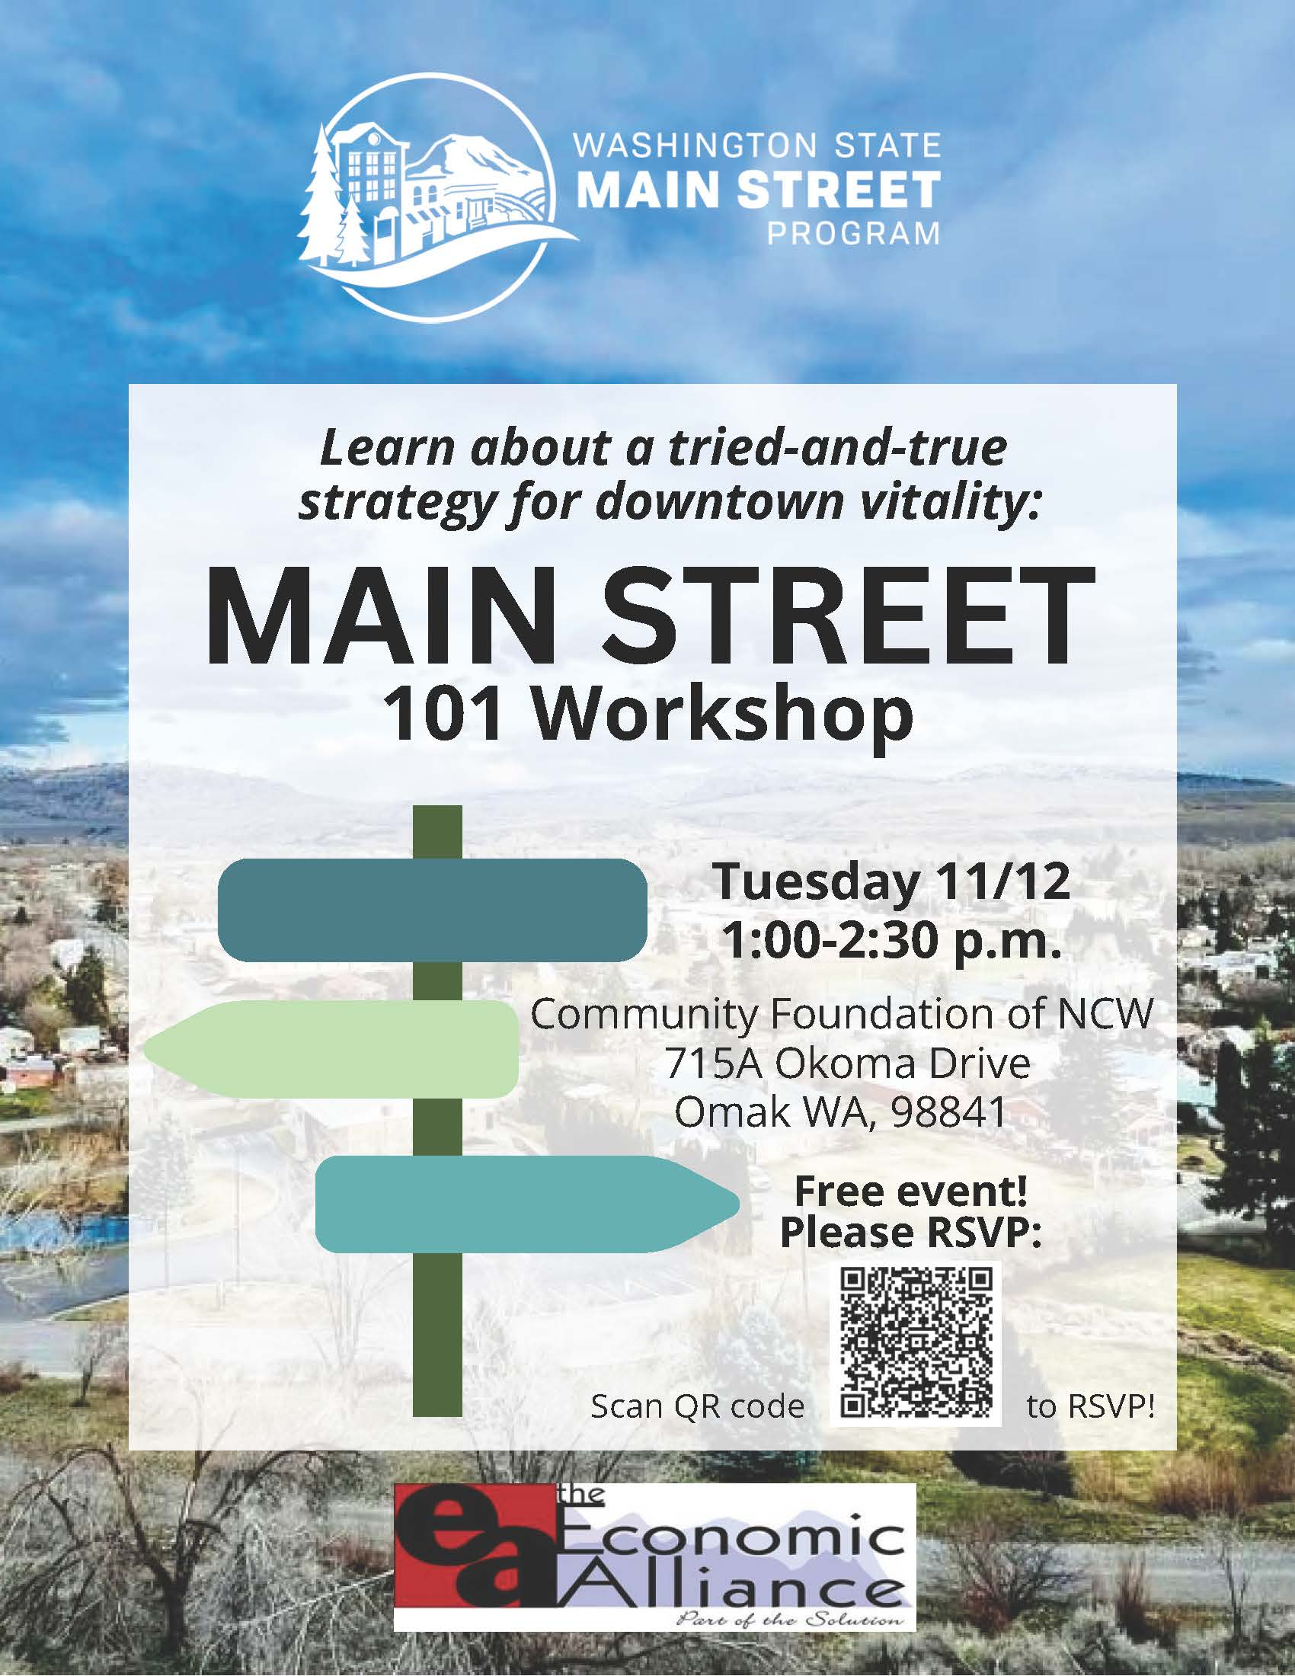
Our Current
Training Calendar

Slide 12
The impacts that the Economic Alliance has on Economic Development in Okanogan County and our Current Projects
Facilitate the OK/CCT Broadband Action Team
84 Million+ in Broadband infrastructure funding brought into Okanogan County since 2019
Updated Broadband and Digital Equity Plans
NCW Workforce Development Council
Partnership with Skillsource to address rural apprenticeship and training for the construction field.
Challenges with Transportation and distance to training sites.
Partner with Worksource on Business Outreach
Latino Small Business Outreach
Provided first time service to 35 Latino Small Business owners
Provide 1 on 1 small business advising
Training and marketing offered in Spanish
Partner with the Northwest Native Development Fund
Co sponsor training and events for Native entrepreneurs
Provide 1 on 1 small business advising
Comprehensive Economic Development Strategy Update
Seeking input from Okanogan County Residents now!
Take Survey!
Facilitate the .09 Public Infrastructure and Community and Economic Development Prioritization Process for Okanogan County
County Commissioners Adopt List by Resolution
Support Letters/Assist in Grant writing & Fund Sourcing
Communities Received Special Appropriations and state and federal dollars due to ranking and project need.
Host and Facilitate the 2024 Workforce Housing Summit
Had over 40 in attendance
Brought in several local, state and federal partners to discuss programs available to address Workforce Housing
Host and Facilitate the 2024 Federal Funding Event
Had 75+ attendees from communities and organizations
Local Tech Team discussions with Federal Funders
On site training in grant writing and technical assistance available.
PARTNER/COLLABORATE
To best serve our small businesses and communities we have to be at the table advocating for them and sharing their story at the larger table.
This is a CHALLENGE, due to limited funding and lack of capacity for small Rural ADO’s like the Economic Alliance.

Slide 13
SBDC 2023 Report
Capital Infusion verified by Clients in writing: $2,219,366.00
Jobs Created and/or retained as verified by Clients: 83
Business Start Ups as verified by Clients: 12+
Total Clients Advised during 2023: 103
**NOTE: These numbers do not reflect outcomes reported through our ADO contract/County contracts/other Grant Funded Programs.

Slide 14
FOLLOW US
To get up to date information on New Programs, Small Business Resources & Training Opportunities.
You can also sign up for our monthly newsletter!

Slide 15
QUESTIONS??

Slide 16
CONTACT INFO
238 East Oak
Okanogan, WA 98840
(509) 826-5107
rholderdiefenbach@economic-alliance.com
mason@economic-alliance.com
Kaelyn@economic-alliance.com
Leonel@economic-alliance.com

